Slide 1
UMET9U-30-1- Professional Skills for Banking and Finance Lecture 12
Presented by
Reinhold Heinlein
December 2025

Slide 2
Lecture content
Probability distributions
Binomial distribution
Normal distribution
Z table

Slide 3
Probability theory – building blocks
An experiment is an activity which has a number of possible outcomes.
A trial is a single performance of the experiment with a single outcome.
The sample space consists of all the possible outcomes. The outcomes in the sample space are mutually exclusive.
The probability of an outcome is the chance of this outcome occurring.
An event is a collection of outcomes within the sample space. Example: event of odd number on the roll of a dice consists of the outcomes 1, 3 and 5.

Slide 4
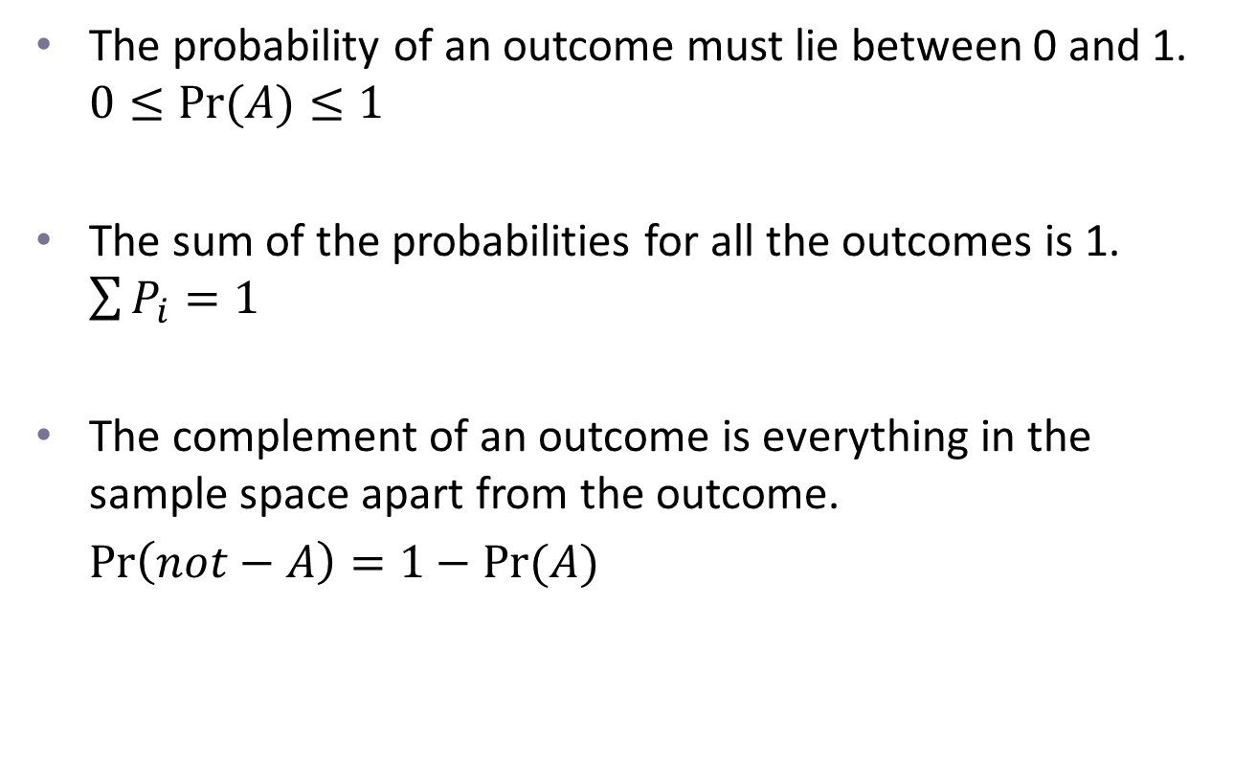
Probability of an outcome
The probability of an outcome must lie between 0 and 1. $0≤Pr⁡(A)≤1$
The sum of the probabilities for all the outcomes is 1. $\sum{P_{i}=1}$
The complement of an outcome is everything in the sample space apart from the outcome.
$\operatorname{Pr}\left(not−A\right)=1−Pr⁡(A)$

Slide 5
Probability distributions
A random variable is one whose outcome is a result of chance.
We have discussed some basic ways in which we can describe a set of actual statistical data: mean, variance, histogram.
But to draw useful conclusions from statistical data, we need to go beyond description, to analysis.
To do this, we need to have some idea, or model of the type of distribution of data we might expect a priori. We can then compare the actual data with the prior expectations.

Slide 6
Some standard probability distributions
Binomial - when the underlying probability experiment has only two possible outcomes (e.g. tossing a coin).
Normal - when many small independent factors influence a variable (e.g. height, influenced by genes, diet, etc.).
Poisson - for rare events, when the probability of occurrence is low.
t distribution – similar like normal, slightly more extreme values.
F distribution – is an asymmetric distribution.

Slide 7
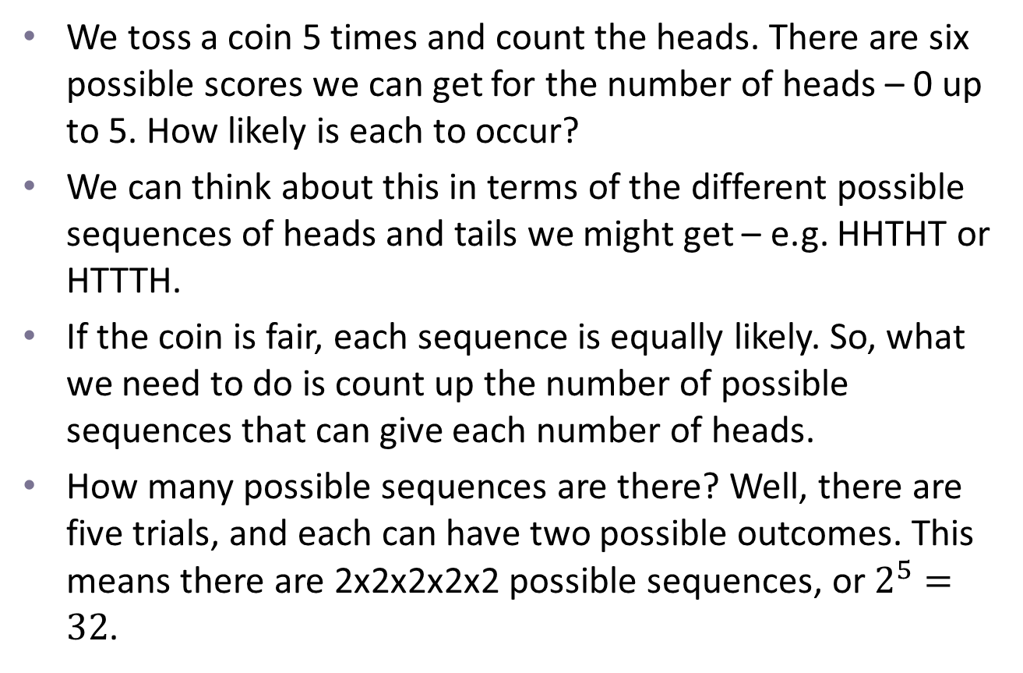
Binomial distribution
We toss a coin 5 times and count the heads. There are six possible scores we can get for the number of heads – 0 up to 5. How likely is each to occur?
We can think about this in terms of the different possible sequences of heads and tails we might get – e.g. HHTHT or HTTTH.
If the coin is fair, each sequence is equally likely. So, what we need to do is count up the number of possible sequences that can give each number of heads.
How many possible sequences are there? Well, there are five trials, and each can have two possible outcomes. This means there are 2x2x2x2x2 possible sequences, or $2^{5}=32$.

Slide 8
Binomial distribution
How many of these sequences give exactly 0 heads? Clearly only 1: TTTTT.
How many give 1 head? There are 5 of these, as the sole head can occur in any of the five tosses – that is, we can get HTTTT, THTTT, TTHTT, TTTHT, TTTTH.
How many give 2 heads? HHTTT, HTHTT, HTTHT, HTTTH, THHTT, THTHT, THTTH, TTHHT, TTHTH, TTTHH. There are 10 in total.
As the distribution is symmetric, we can infer the second half.

Slide 9
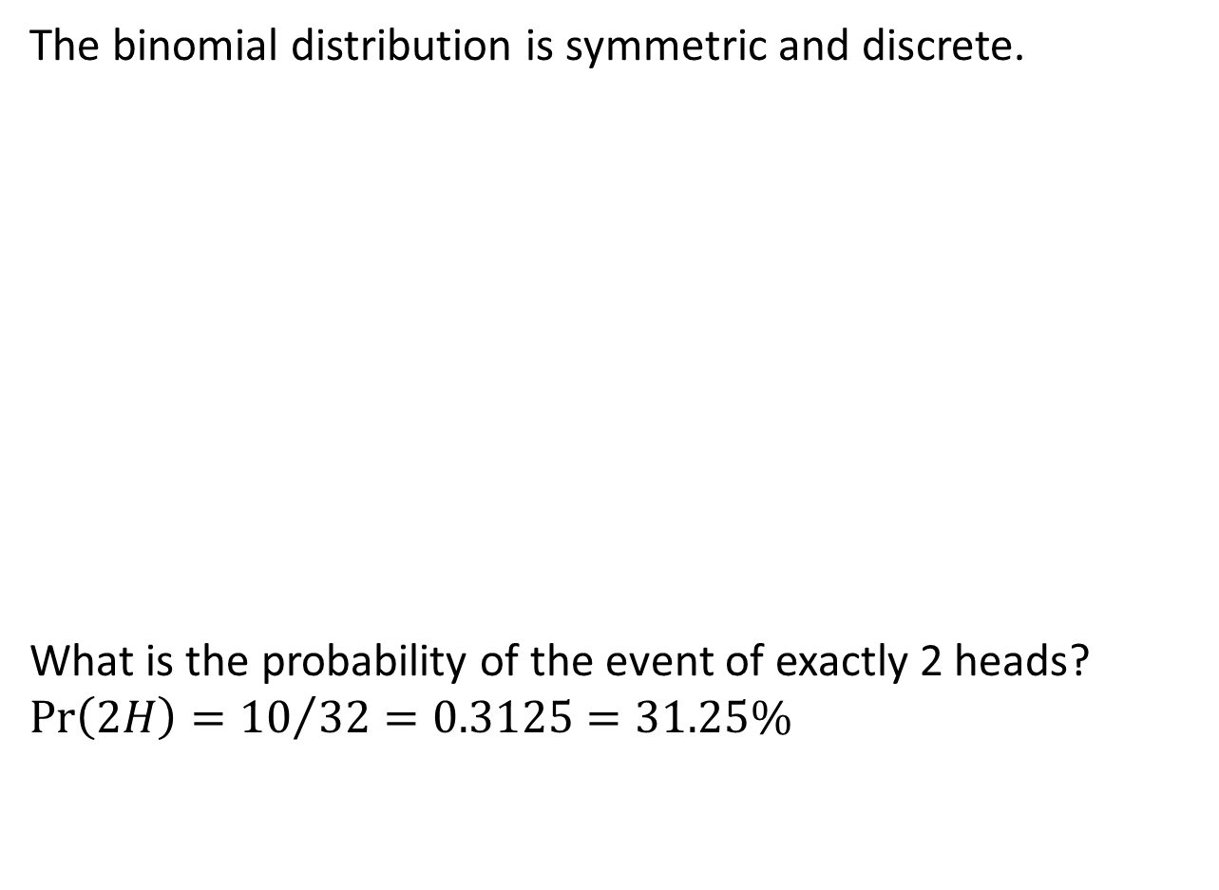
Binomial distribution
The binomial distribution is symmetric and discrete.
What is the probability of the event of exactly 2 heads?
$$\operatorname{Pr}\left(2H\right)={10}/{32}=0.3125=31.25\%$$

Slide 10
Normal distribution
Normal distributions are continuous – that is, they can take any value, or any value in a given range – for example the height, weight or income of a randomly selected individual.
A lot of variables in the real world tend to have a particular shape of distribution – the normal distribution – and a lot of statistical analysis is based on the assumption that certain variables follow some sort of normal distribution.

Slide 11
Normal distribution
Characteristics of any normal distribution:
Bell-shaped
Symmetric about mean
Continuous
Never touches the x-axis
Total area under curve is 1.00
Approximately 68% lies within 1 standard deviation of the mean, 95% within 2 standard deviations, and 99.7% within 3 standard deviations of the mean.

Slide 12
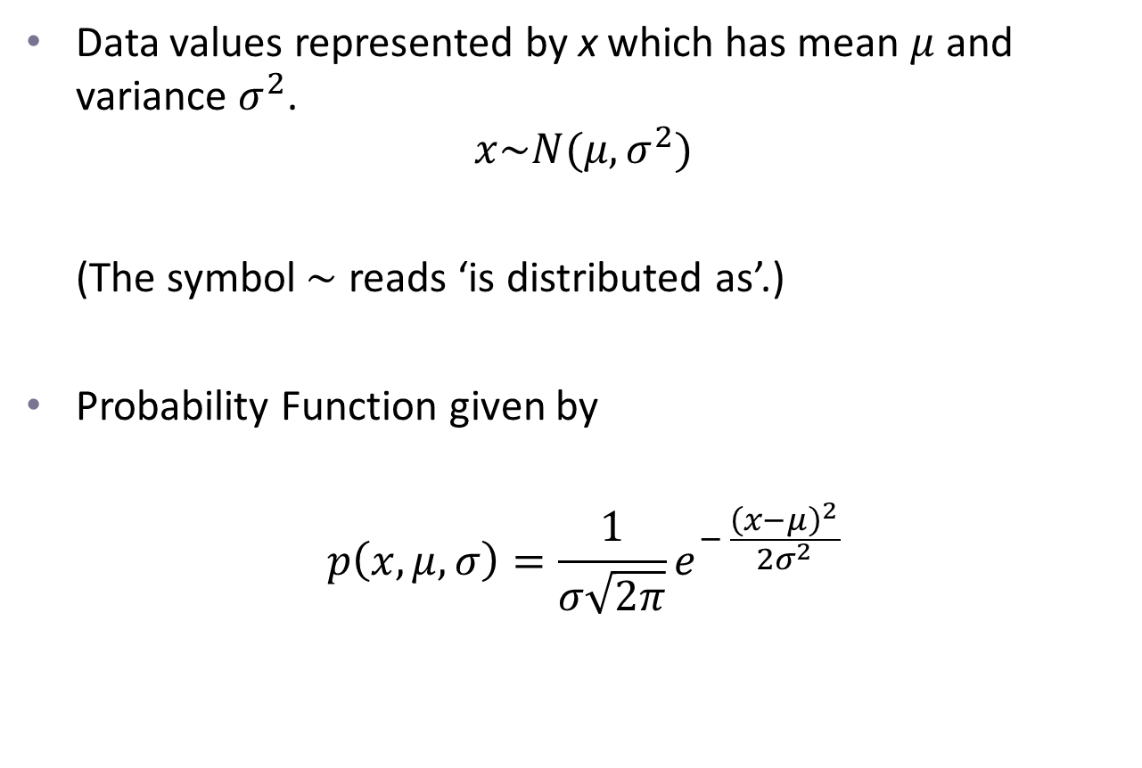
Normal distribution
Data values represented by x which has mean $μ$ and variance $σ^{2}$.
$$x\sim N(μ, σ^{2})$$
(The symbol $\sim$ reads ‘is distributed as’.)
Probability Function given by
$$p\left(x, μ, σ\right)=\frac{1}{σ\sqrt{2π}}e^{− \frac{{\left(x−μ\right)}^{2}}{2σ^{2}}}$$

Slide 13
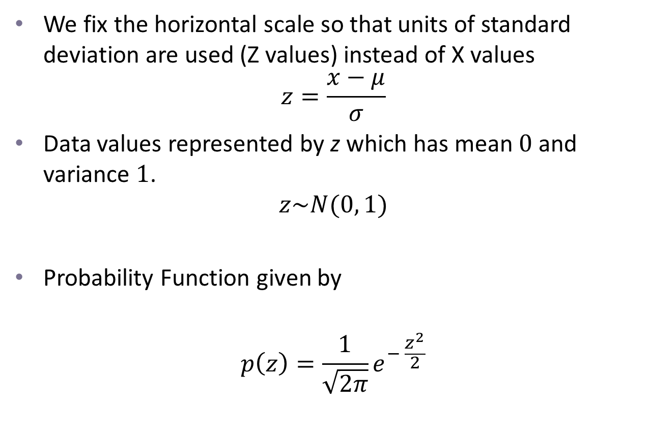
The Standard Normal Curve
We fix the horizontal scale so that units of standard deviation are used (Z values) instead of X values
$$z=\frac{x−μ}{σ}$$
Data values represented by z which has mean $0$ and variance $1$.
$$z\sim N(0, 1)$$
Probability Function given by
$$p\left(z\right)=\frac{1}{\sqrt{2π}}e^{− \frac{z^{2}}{2}}$$

Slide 14
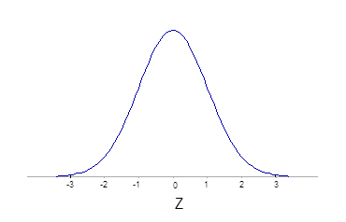

The Standard Normal Curve
$$z=\frac{x−μ}{σ}$$
Example: If mean = 40 and standard deviation = 10
When x = 50 z = 1
When x = 30 z = -1
When x = 60 z = 2

Slide 15
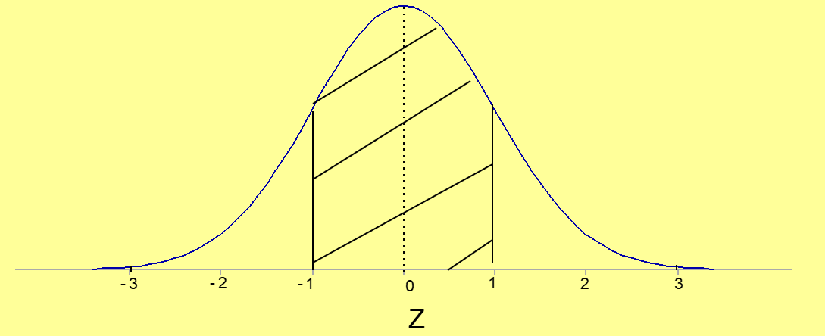
Areas under the Curve
This area is 0.6826.
68.26% of values are within 1 standard deviation of the mean. There is a probability of 0.68 that a value will lie in this region.

Slide 16
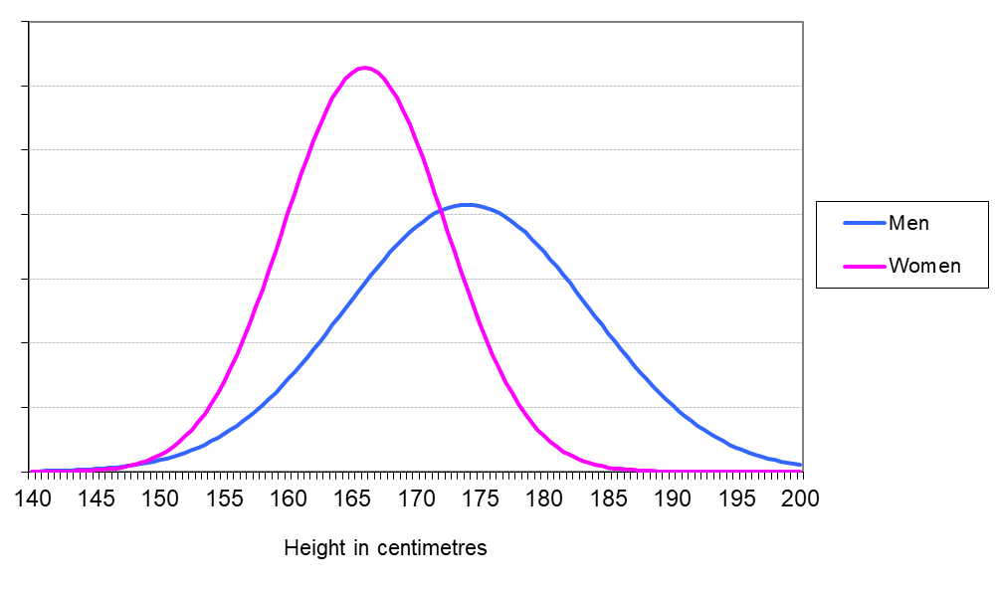

Example: probability density functions of men’s and women’s heights
Let’s assume heights are normally distributed.
$$x_{M}\sim N\left(174, 92.16\right)$$
and
$$x_{W}\sim N\left(166, 40.32\right)$$

Slide 17
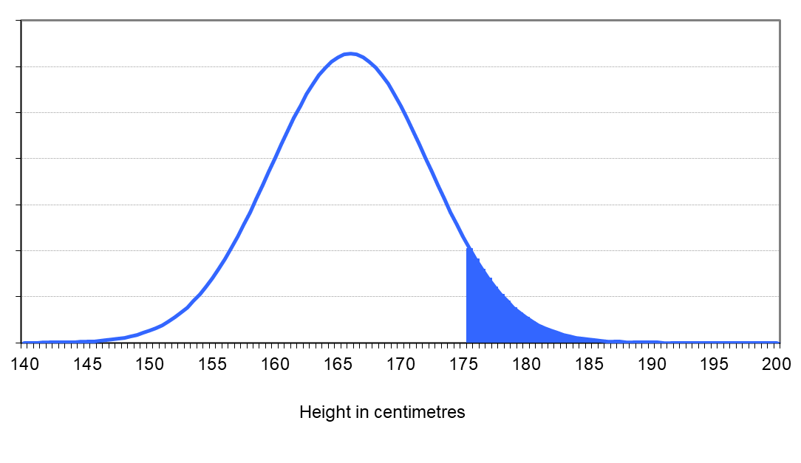
Example: what proportion of women are taller than 175 cm?
We need the blue area.

Slide 18
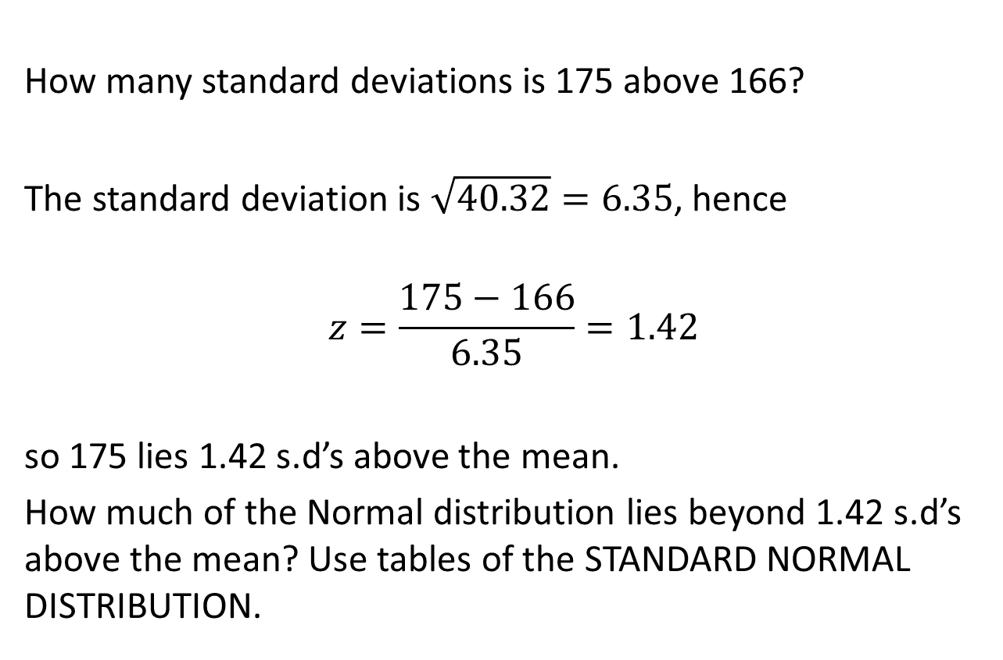
Example: what proportion of women are taller than 175 cm?
How many standard deviations is 175 above 166?
The standard deviation is $\sqrt{40.32}=6.35$, hence
$$z=\frac{175−166}{6.35}=1.42$$
so 175 lies 1.42 s.d’s above the mean.
How much of the Normal distribution lies beyond 1.42 s.d’s above the mean? Use tables of the STANDARD NORMAL DISTRIBUTION.

Slide 19
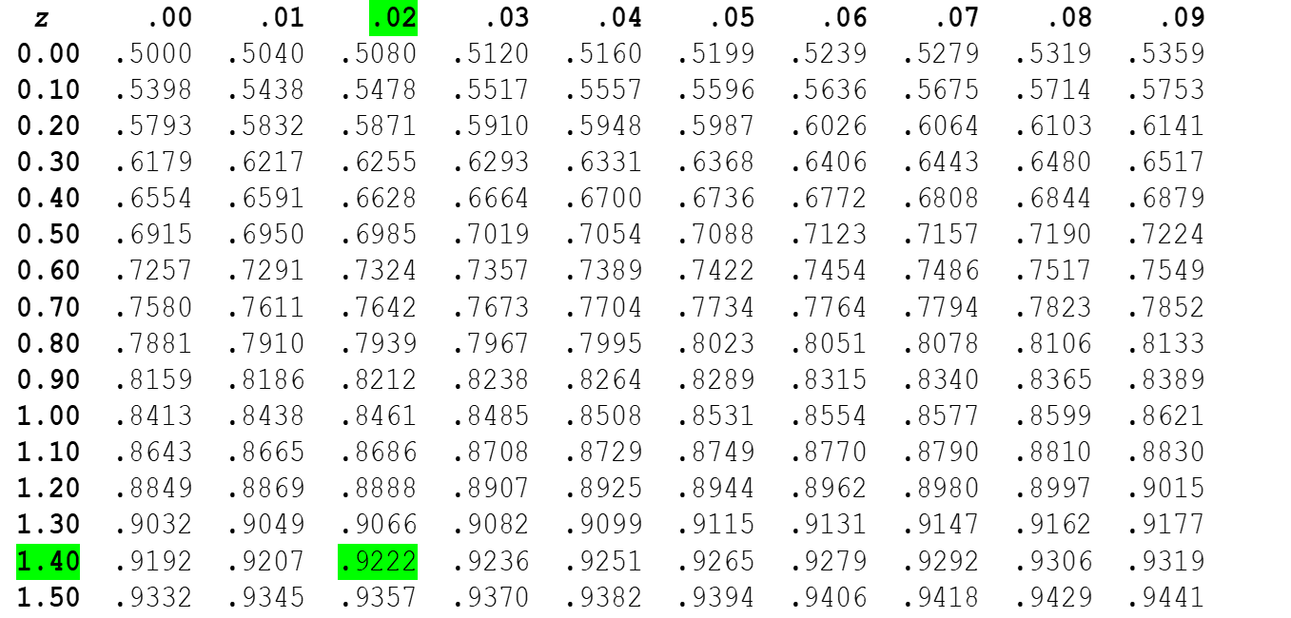

The Z table
Body of table gives area under Z curve to the left of z
$$P\left(X>1.75\right)=P\left(Z>1.42\right)=1−0.9222=0.0778$$
7.78% of women are taller than 175 cm

Slide 20
Next Lecture
Programming with Python

